Slide 2

Predicting AMES Housing Prices
Machine Learning Kaggle Project
Christina
Mike
Shehryar
Yan

Slide 3
Why care?
Information for homebuyers
Factors can potentially effect house prices in Iowa
Machine learning helping to make informed decisions

Slide 4
What we wanted to discover
What factors are important for determining the price?
How well can we predict prices?
Which model is the best suited for the task

Slide 5
Teamwork makes the dream work!
EDA as a team → imputation & feature selection
Cleaning
Linear
Tree
Tune models
Share and compare results
Recalibrate models based on best features/top models

Slide 6
EDA and feature engineering
EDA and Imputation
Feature Eng. & Selection
Modelling
& Tuning
Performance Check
Linear models
MLR
Ridge
Lasso
Tree models
RF
XGB
Understand and visualize data
Create/ drop features
Submit predicted data to recalibrate models
Impute missing data
Feature selection
Tuning models through gridsearch

Slide 7
Exploratory Data Analysis
Go through data set
Plot distributions and box plots
Check correlation
Check for Z scores and outliers

Slide 8
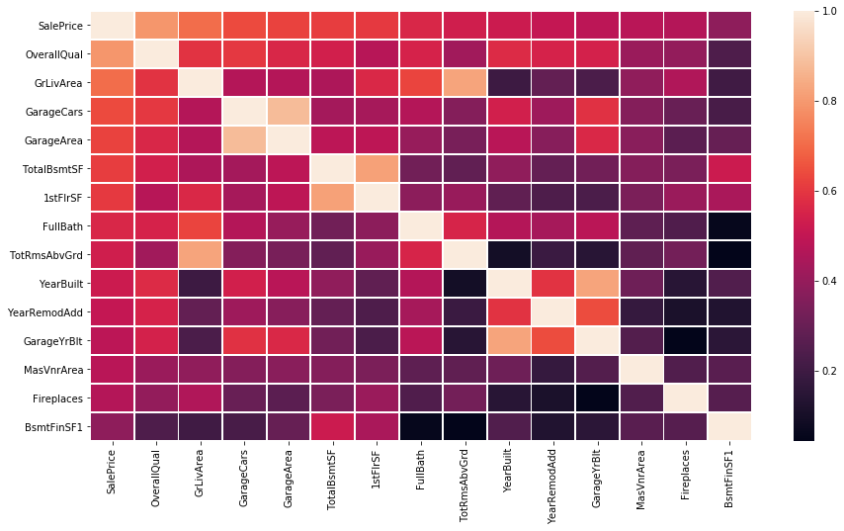
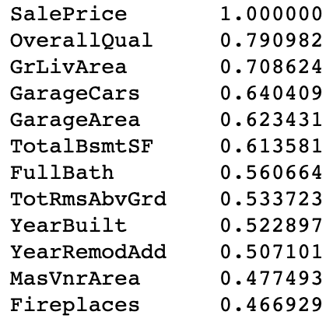
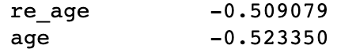
Correlation Matrix
Correlation with SalePrice

Slide 9
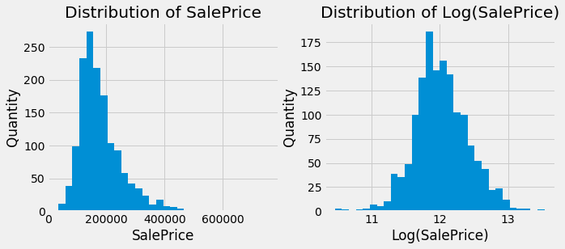
Distribution Plots

Slide 10
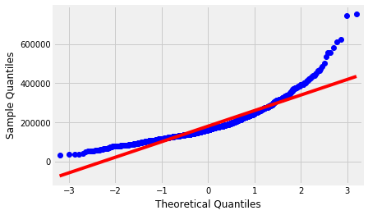
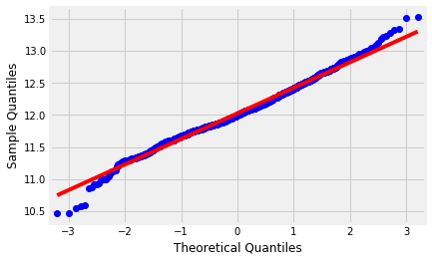
Quantile Plots
Quantiles SalePrice
Quantiles Log(SalePrice)

Slide 11
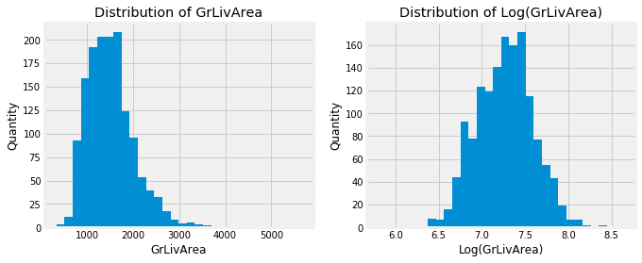
Distribution Plots

Slide 12
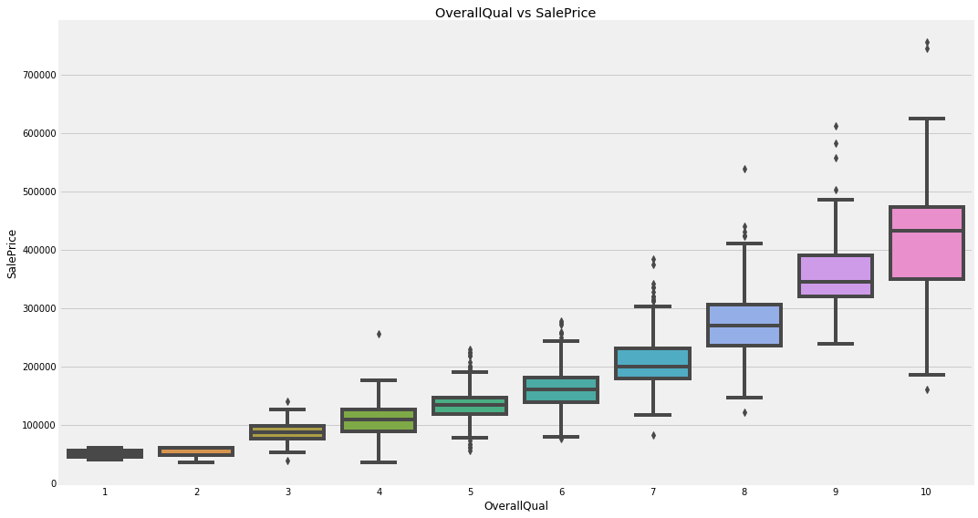
Box Plots

Slide 13
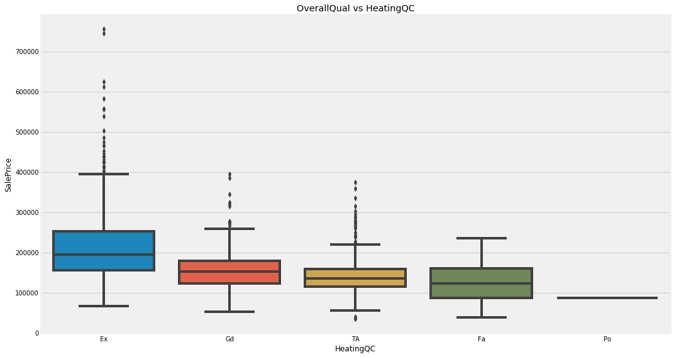
Box Plots

Slide 14
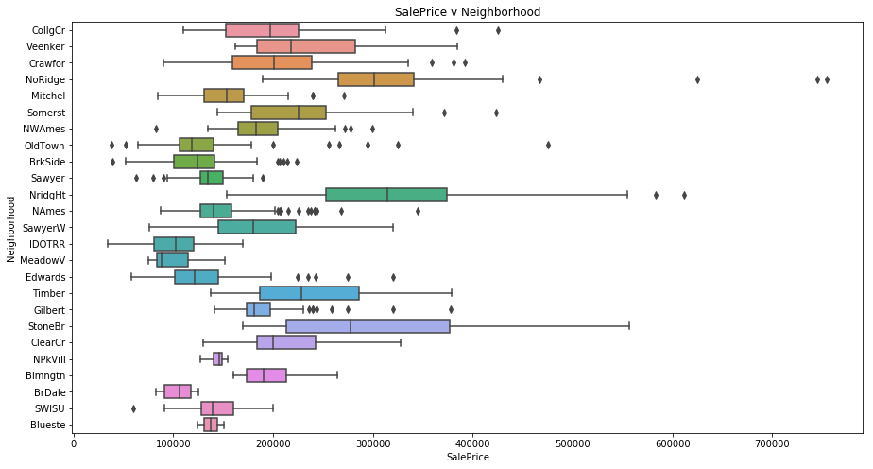
Box Plots

Slide 15
Dealing with Missing values
Go through data set
Plot distributions and box plots
Check correlation
Check for Z scores and outliers
Checked / filled missing values

Slide 16
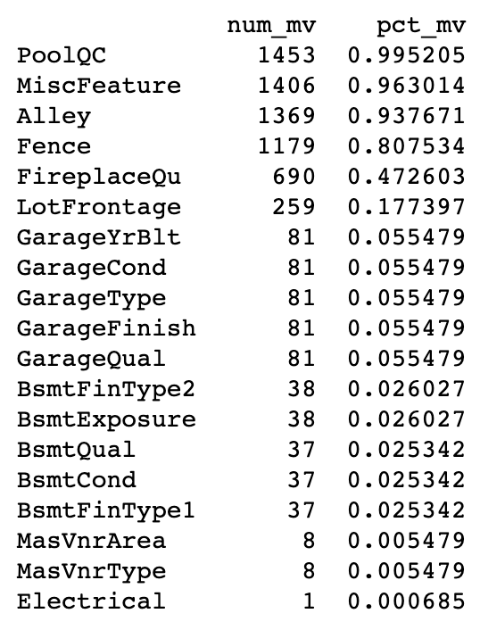
Missing values
Action taken
Alley
Bsmt+
FireplaceQu
Fence
Garage+
PoolQC
MasVnr+
Replace with None or 0
Imputed using neighbourhood LotArea (regression) or neighbourhood median LotFrontage
LotFrontage
Electrical
Used Mode to impute
MiscFeature
Replaced with None → column dropped

Slide 17
Feature Selection and engineering
Study data set
Plot distributions and box plots
Check correlation
Check for Z scores and outliers
Checked / filled missing values
Feature Selection & Engineering

Slide 18
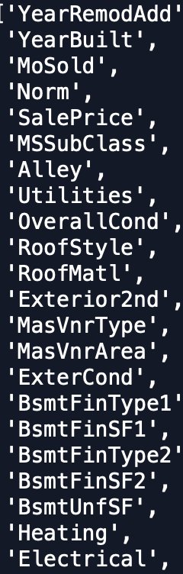
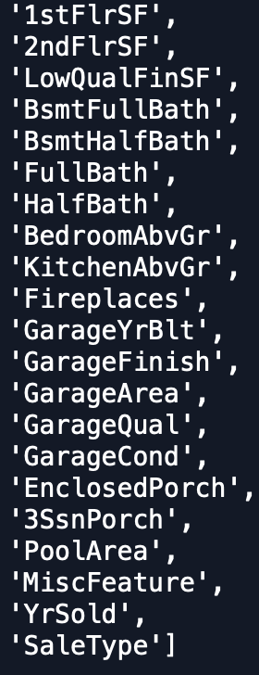
Features engineering and selection
HalfBath + Full Bath
TotalBath
Functional
Typical/ Non Typical
PoolQC
Pool/ No Pool
MoSold
Seasons
Condition
Combines Condition 1&2
Year Built/Remodeled
Age / ReAge
- combined and dropped variables based on EDA
- show what we dropped and merged
- left with around 52 features our of 80

Slide 19
Modeling and Tuning
EDA and Imputation
Feature Eng. & Selection
Modelling
& Tuning
Performance Check
Linear models
MLR
Ridge
Lasso
Tree models
RF
XGB
Understand and visualize data
Create/ drop features
Submit predicted data to recalibrate models
Impute missing data
Feature selection
Tuning models through gridsearch

Slide 20
ML adventure
Ridge/Lasso/
Random forest with 80 features
Ridge/Lasso/
Random forest with
50 features
Add More features, use robust scaler
Ridge RMSE: 0.1201
Lasso RMSE: 0.1203
Random forest: 0.144
Ridge RMSE: 0.129
Lasso RMSE: 0.1373
Random forest: 0.153
Ridge RMSE: 0.120
Lasso RMSE: 0.118
Random forest: 0.149
Multilinear stacked+ weighted stacked(adjust weight)
xgBoost/ stacked model
W_stack: 0.1169
M_stack :0.23
xgBoost: 0.123
Stacked :0.118

Slide 21

ML adventure
ADD FEATURE:
Totalhouse= TotalBsmtSF+ 1stFlrSF + 2ndFlrSF
House_qual=TotalHouse * OverallQual
Gr_quak=GrLivArea* OverallQual
Robust Scaler to fix outliers

Slide 22
ML Work flow and tuning
Ridge
Created features
Scaled features
Grid Search alpha(0,15,10000)
Cross Validation = 5 folds
Lasso
Created features
Scaled features
Grid Search alpha((0.0001, 0.01, 500))
Cross Validation = 6 folds
Random Forest
Original features
Scaled features
Grid Search {﻿ "n_estimators": [650],
"min_samples_leaf": [2],
"min_samples_split": [2],
"random_state": [42]}
Cross Validation = 5 folds
xgBoost
Originsl features
Scaled features

Slide 23
ML adventure
Model Stacking
Ridge
Lasso
Random forest
xgBoost
Weigh
0.27
0.48
0.02
0.23
Third dataset after add features
Second dataset with
Original 80 features

Slide 24
Domain Knowledge - How It Helped
Immediate understanding of most variables
What is an irregular lot?
Instinct on which would matter
Lot frontage is not a big deal in residential real estate
Uses of model outside of strictly predicting house price
After seeing weight of certain factors, steer marketing of home in certain direction

Slide 25
Domain Knowledge - Where It Didn’t Help
Multicollinearity
A feature may be intuitively important, though it’s value may be contained elsewhere
House Age had a VIF of 10
Neighborhoods
Never been to Ames, Iowa, therefore, no domain knowledge

Slide 26
RMSE Scores
Model | Best Score
Stacked Model | 0.1169
Lasso | 0.1189
Ridge | 0.1201
XGB | 0.1256
VIF | 0.1422
Random Forest | 0.1449

Slide 27
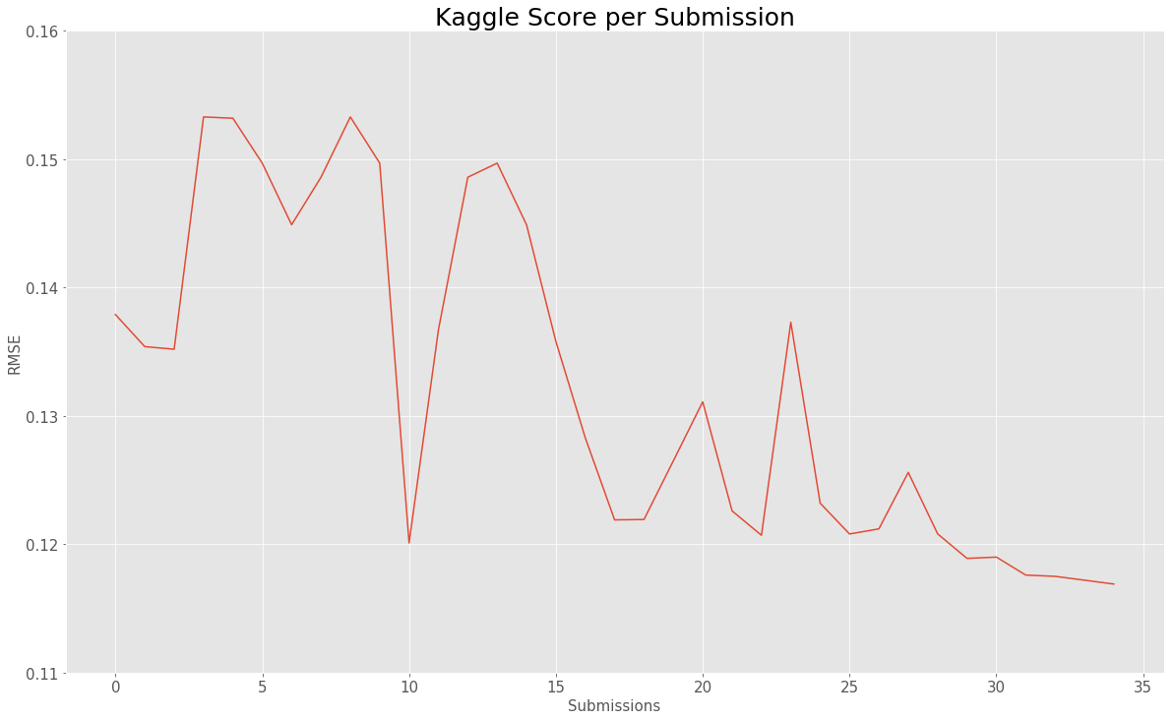
RMSE Scores

Slide 28
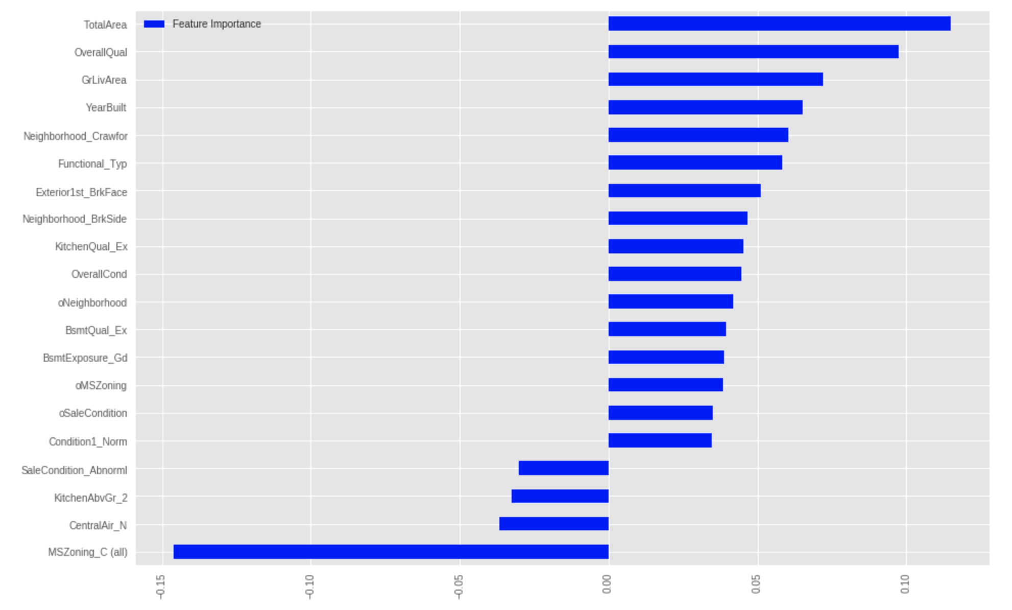
Lasso Features Importance

Slide 29
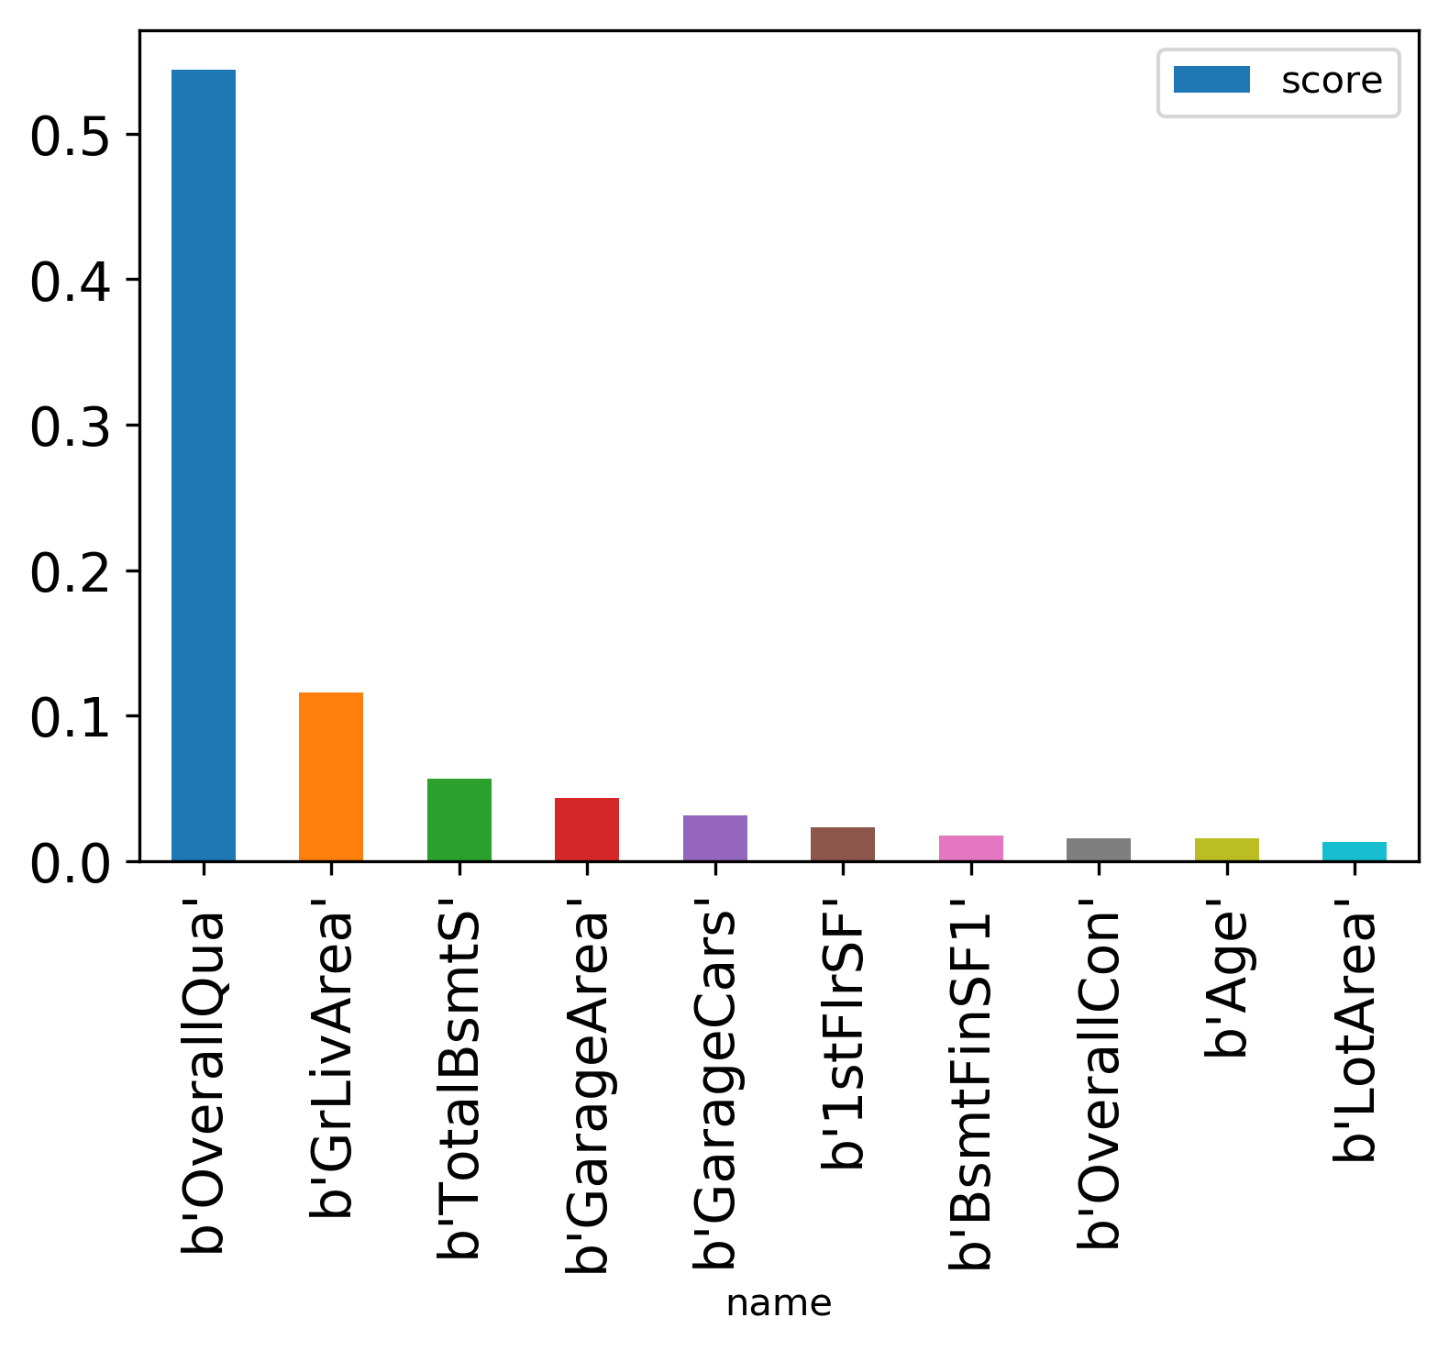
Lasso Features Importance

Slide 30
Model Overview
Both Lasso and Random Forest assigned strong weights to Overall Quality and Gross Living Area
Ensemble method in which a new model is trained from the predictions of previous models
Helps to counteract weaknesses of different models

Slide 31
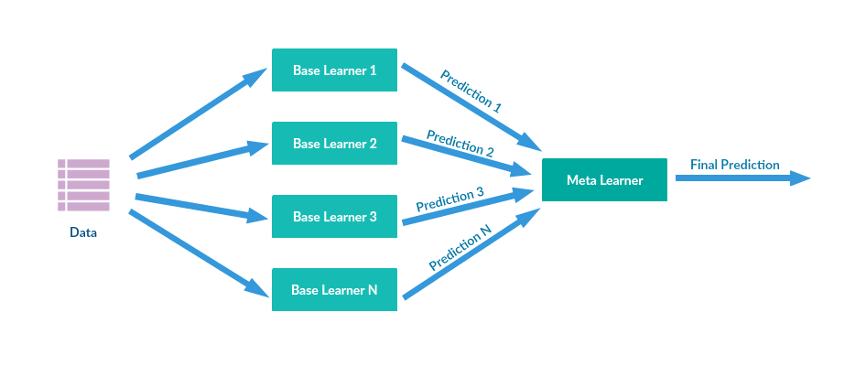
Methodology - Stacking
Ensemble method in which a new model is trained from the predictions of previous models
Helps to counteract weaknesses of different models
Image Source: https://medium.com/@rrfd/boosting-bagging-and-stacking-ensemble-methods-with-sklearn-and-mlens-a455c0c982de

Slide 32
Next Steps
More feature engineering
More subtle use of the model to analyze which features are most important
Can be helpful for renovations and brokers preparing marketing materials

